Slide 1
Dynamic XPATH

Slide 2
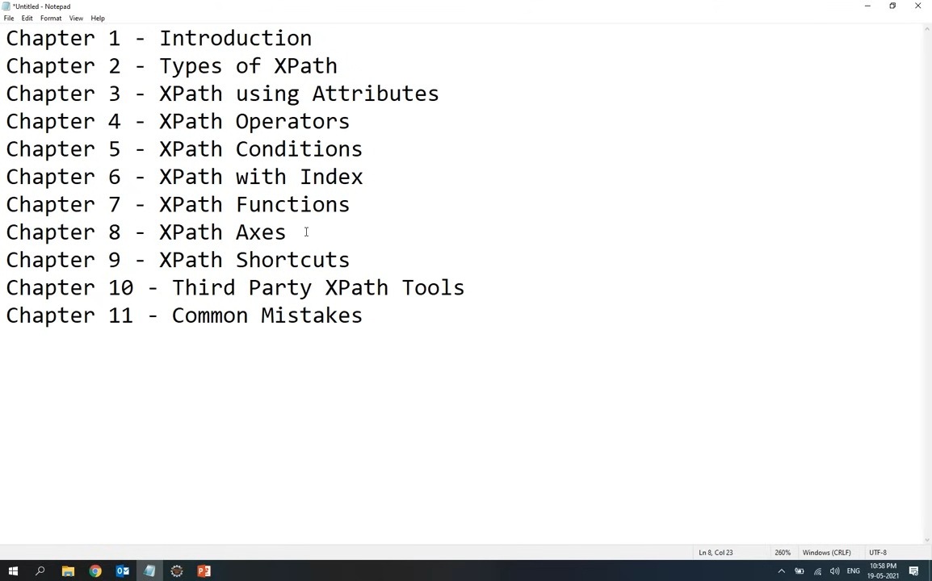

Slide 3
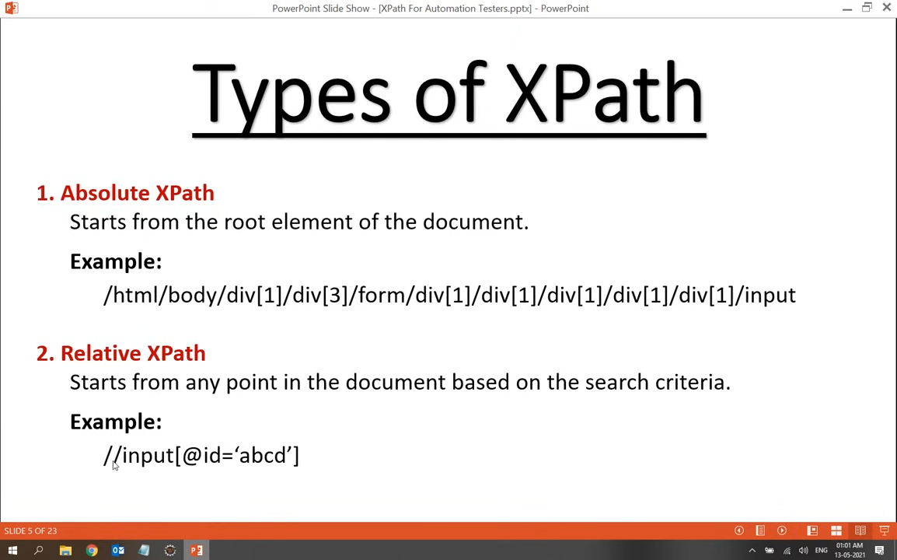

Slide 4
DYNAMIC XPATH
Absolute xpath start with single slash
Relative xpath start with double slash
Absolute XPath
Syntax:/html/body/div[1]/form/input[1]
Characteristics:
Starts from the root node (/html) and follows the full path to the element.
Uses single forward slash (/) to denote hierarchy.
Fragile: If any structure in the HTML changes, it will break.
driver.find_element(By.XPATH, "/html/body/div[1]/form/input[1]")

Slide 5
Relative XPath
Relative XPath://tagname[@attribute='value']
Characteristics:
Starts with double slash (//) which can search anywhere in the DOM
More flexible and reliable than absolute XPath. Allows use of functions like contains(), starts-with(), text(), etc.

Slide 6
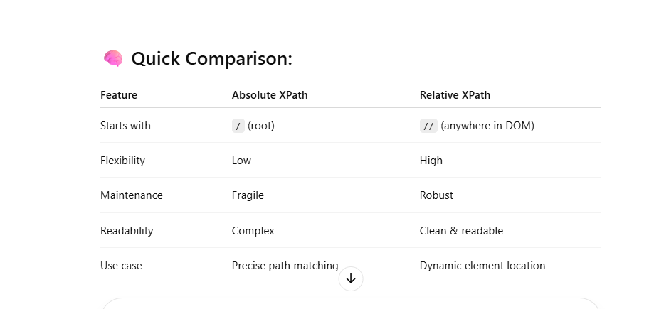

Slide 7
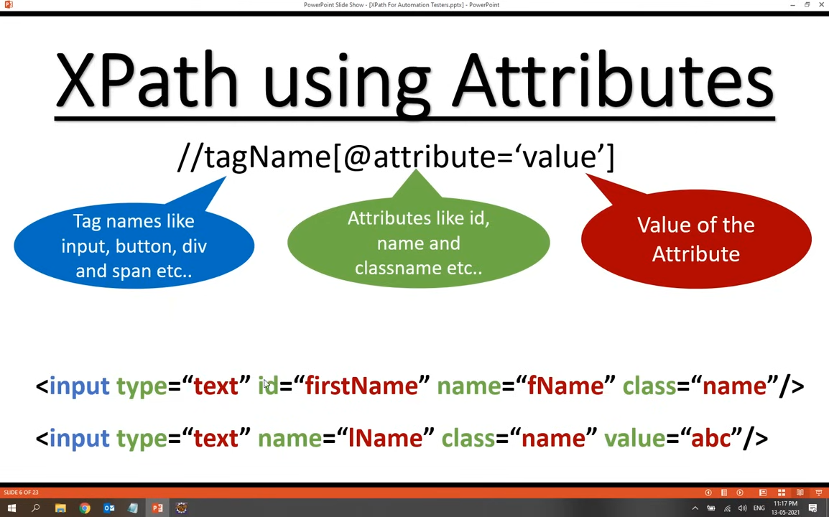
Xpath using attributes

Slide 8
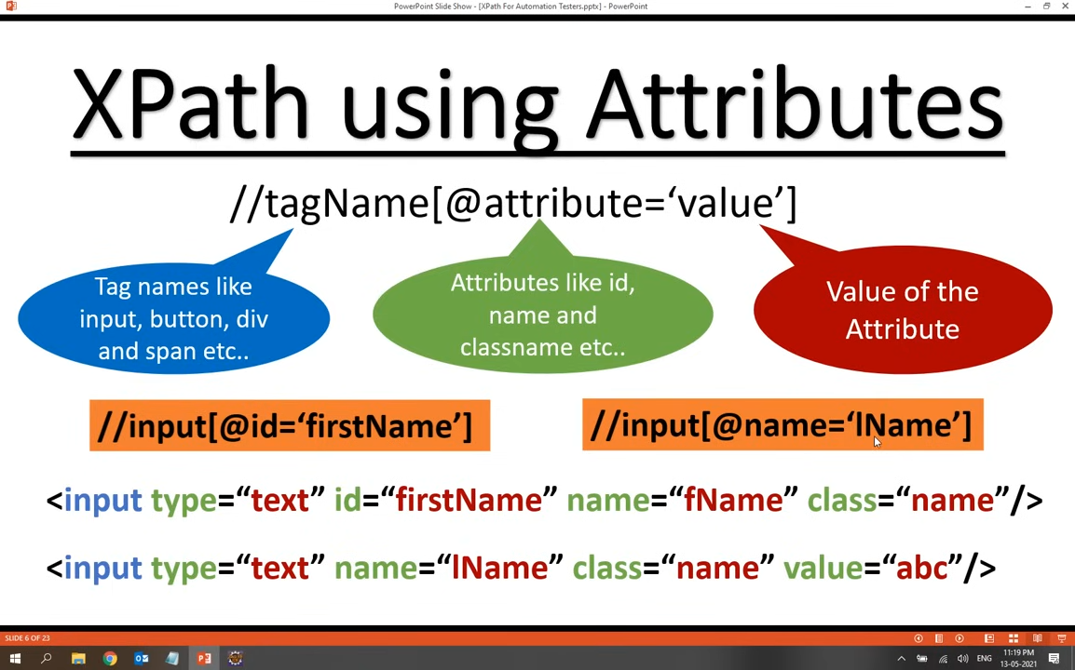

Slide 9
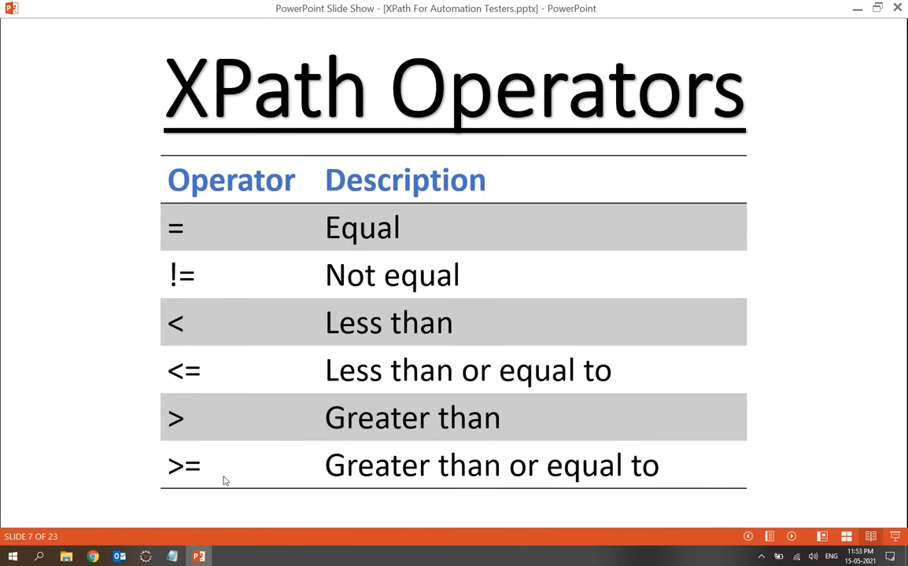

Slide 10
Operators examples
.//input[@maxlength==10] ……………….(text/numeric)
.//input[@maxlength!=10] ………………..(text/numeric)
//input[@maxlength<10] ………………….(only numeric)
//input[@maxlength>10] ………………….(only numeric)
//input[@maxlength<=10].........................(only numeric)
//input[@maxlength>=10].........................(only numeric)

Slide 11
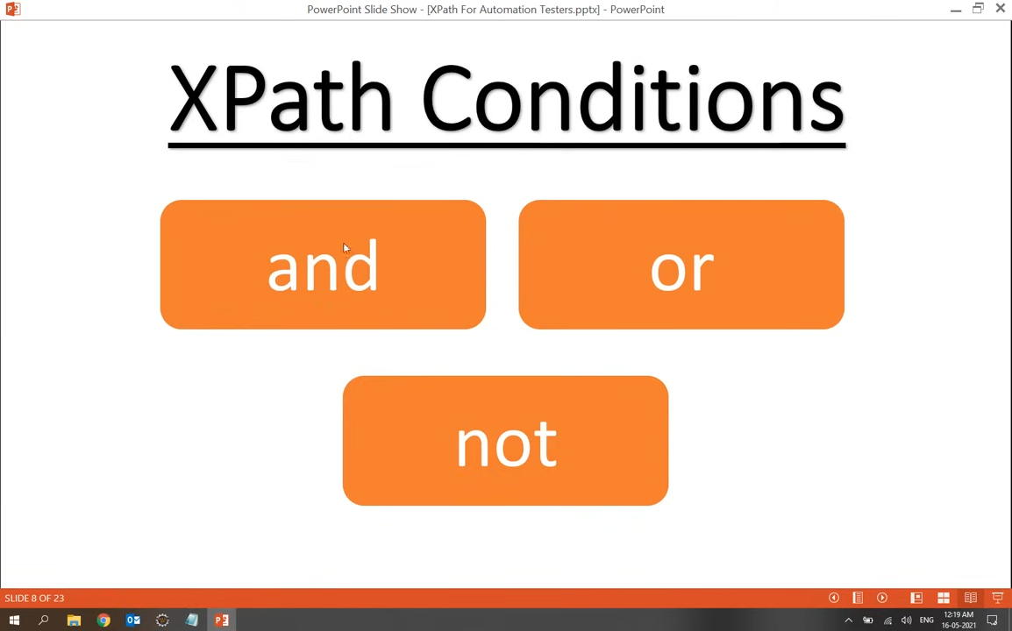

Slide 12
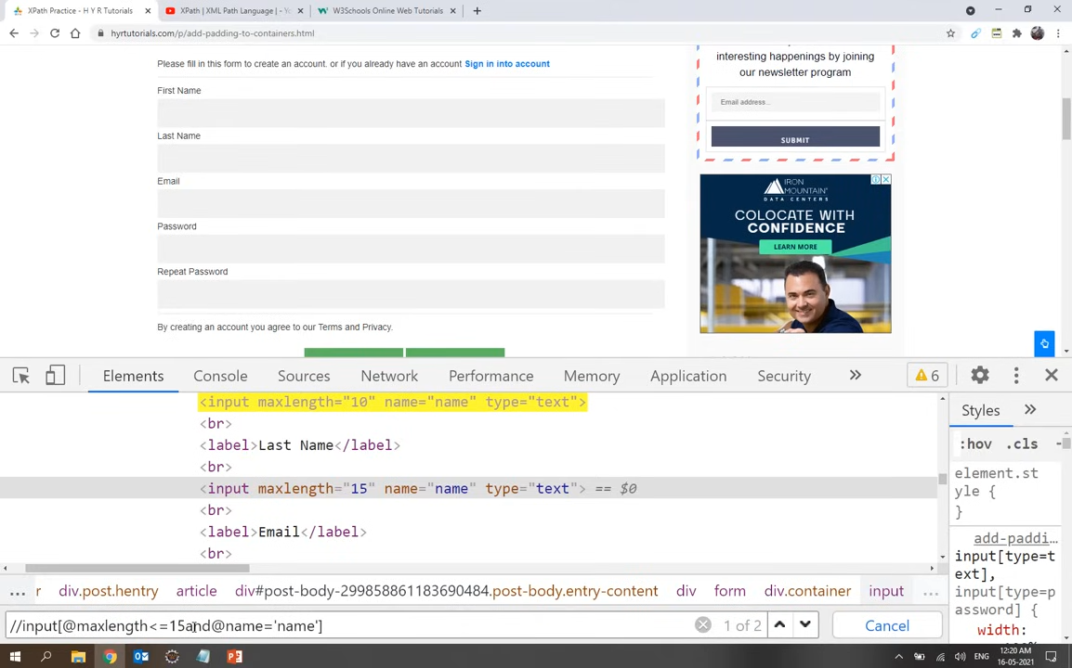

Slide 13


Slide 14
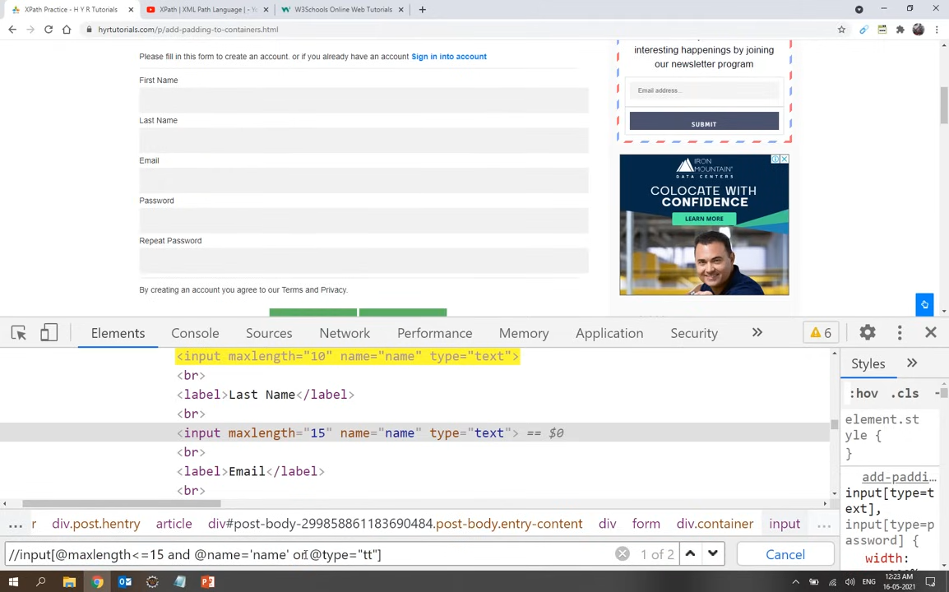

Slide 15
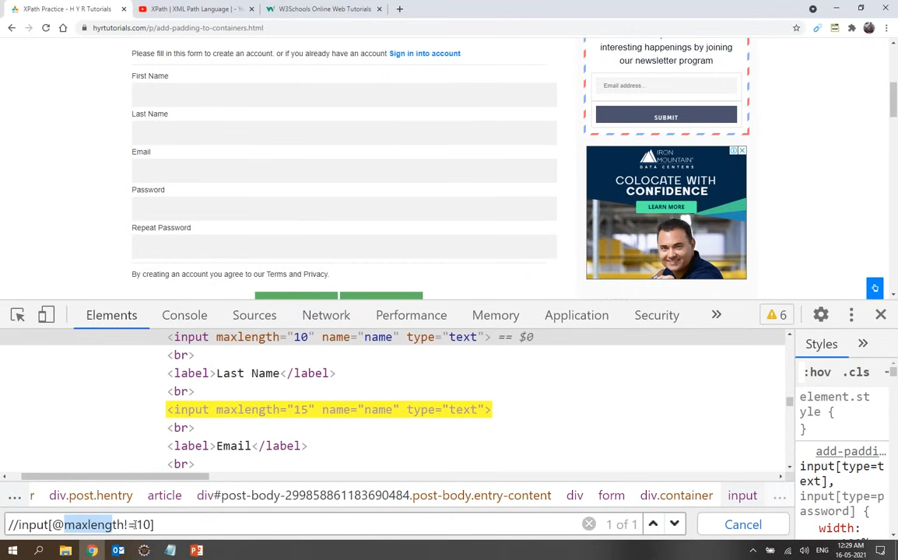

Slide 16
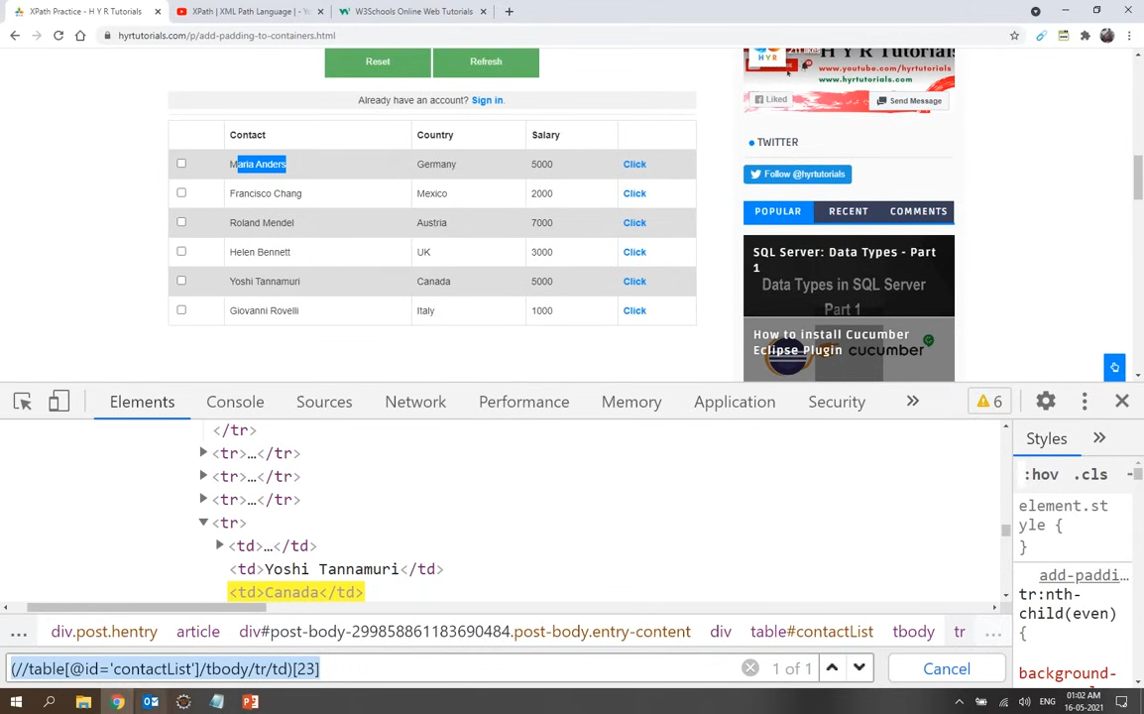

Slide 17
(//table[@name='BookTable']/tbody/tr/td)[5]
The above xpath indicates the we dive into table and read data inside the cell

Slide 18


Slide 19
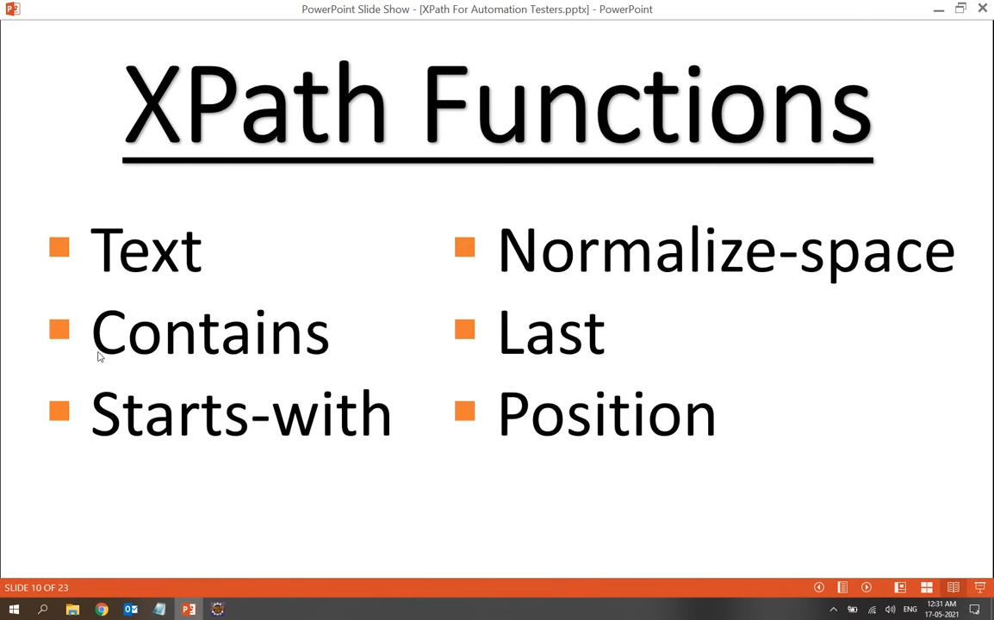

Slide 20
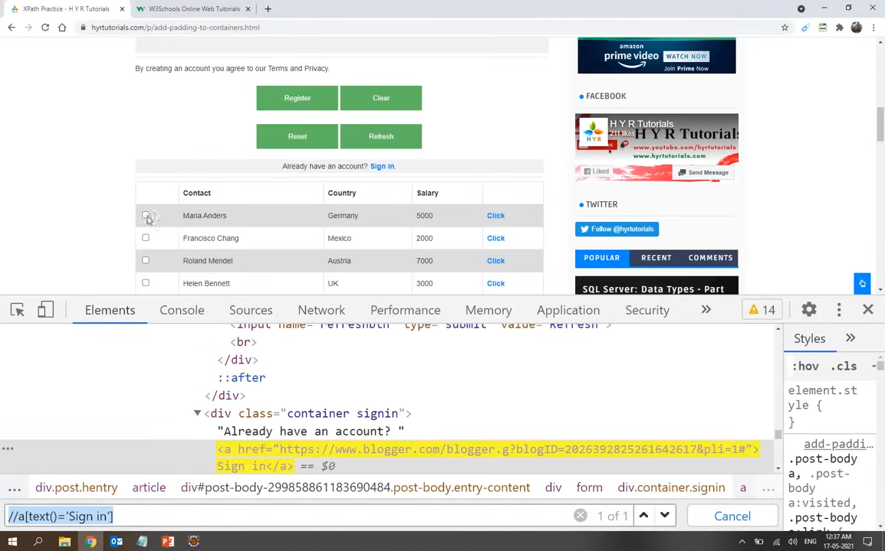

Slide 21
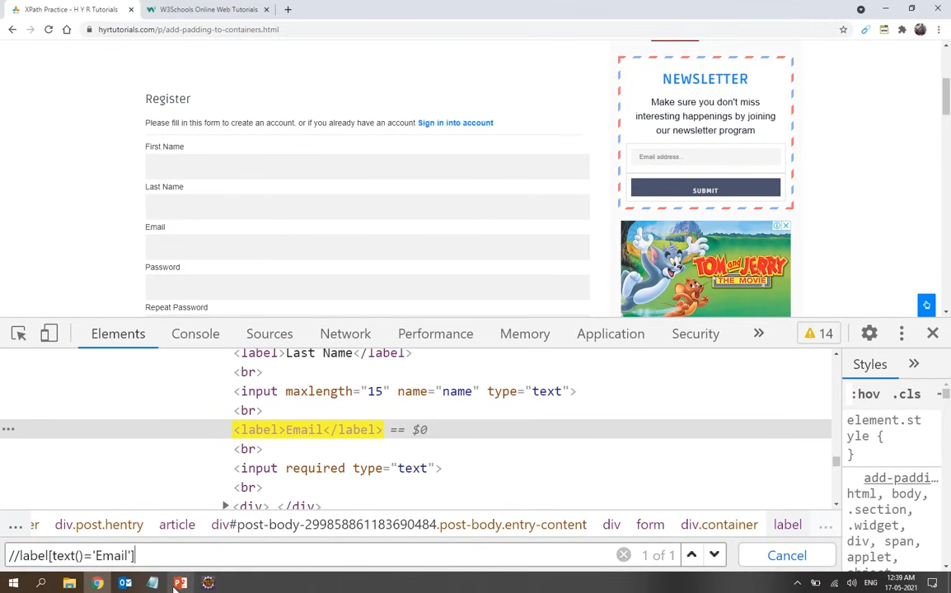

Slide 22
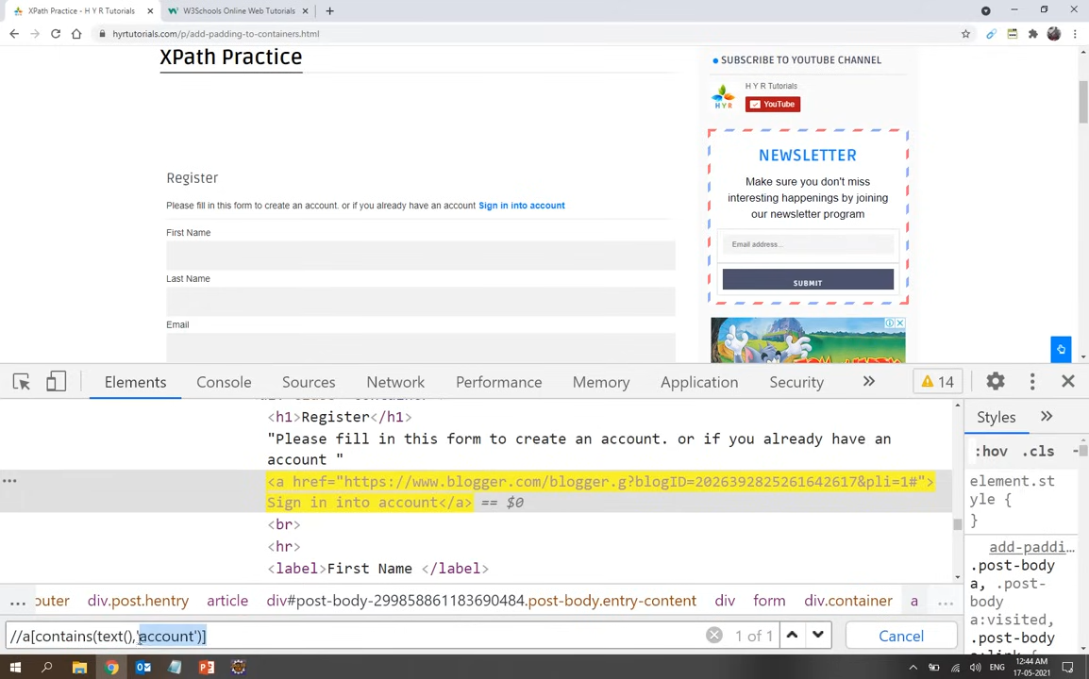

Slide 23
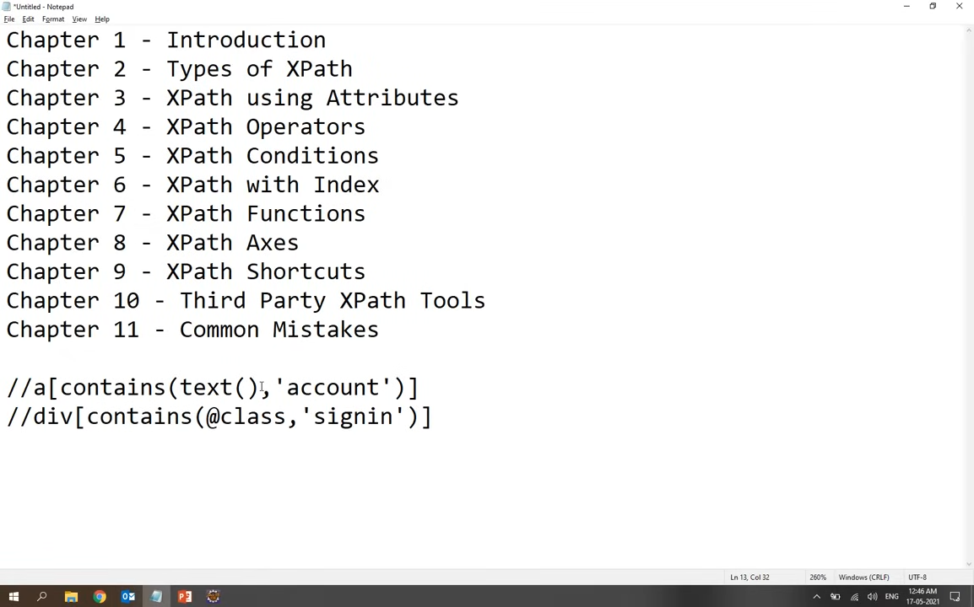

Slide 24
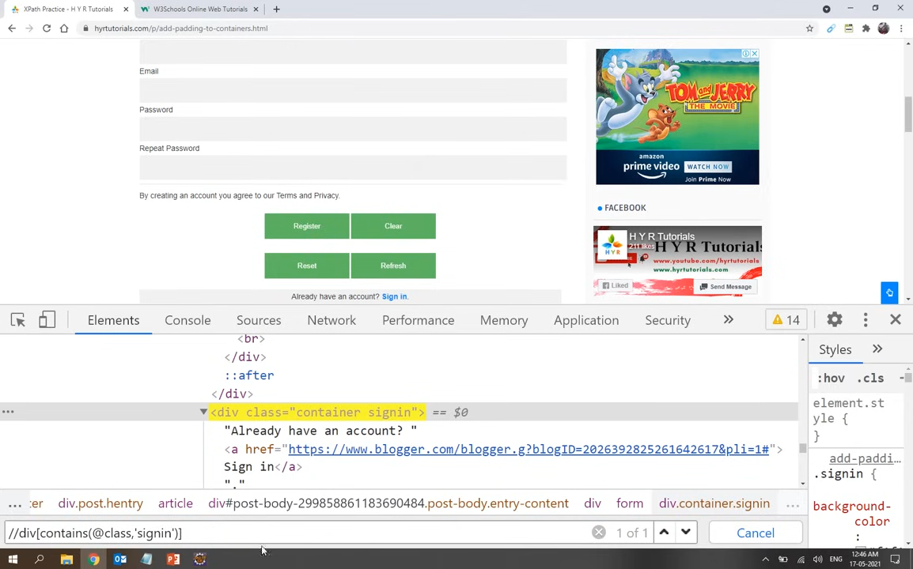

Slide 25
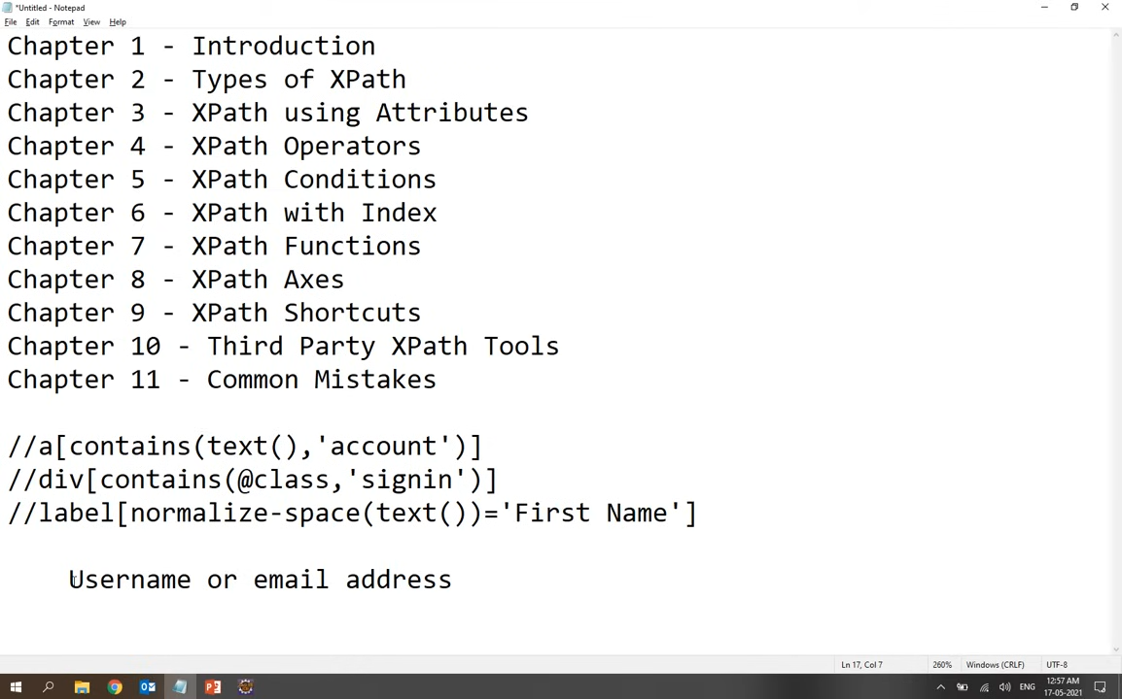
normalise function is used to remove the space between elements and identify
It will remove the staring and ending space will remove

Slide 26
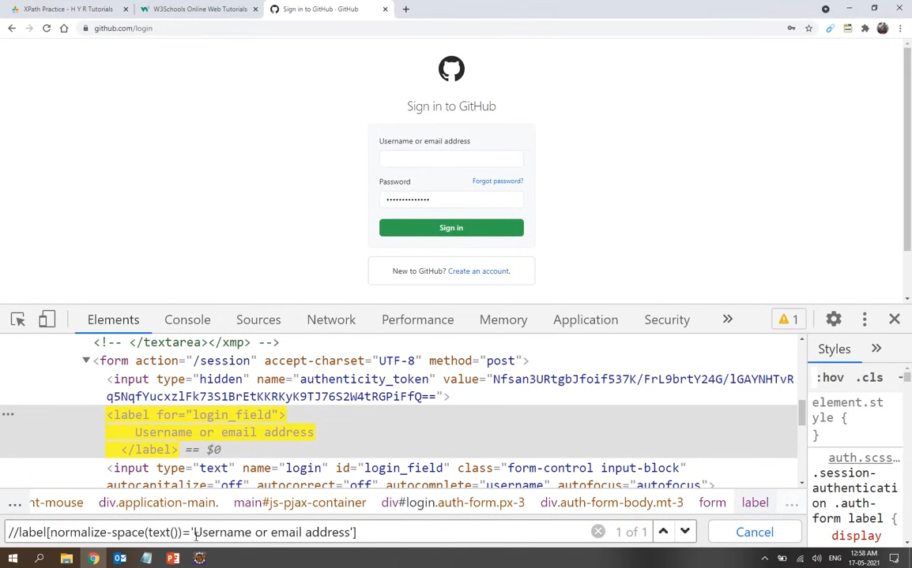

Slide 27
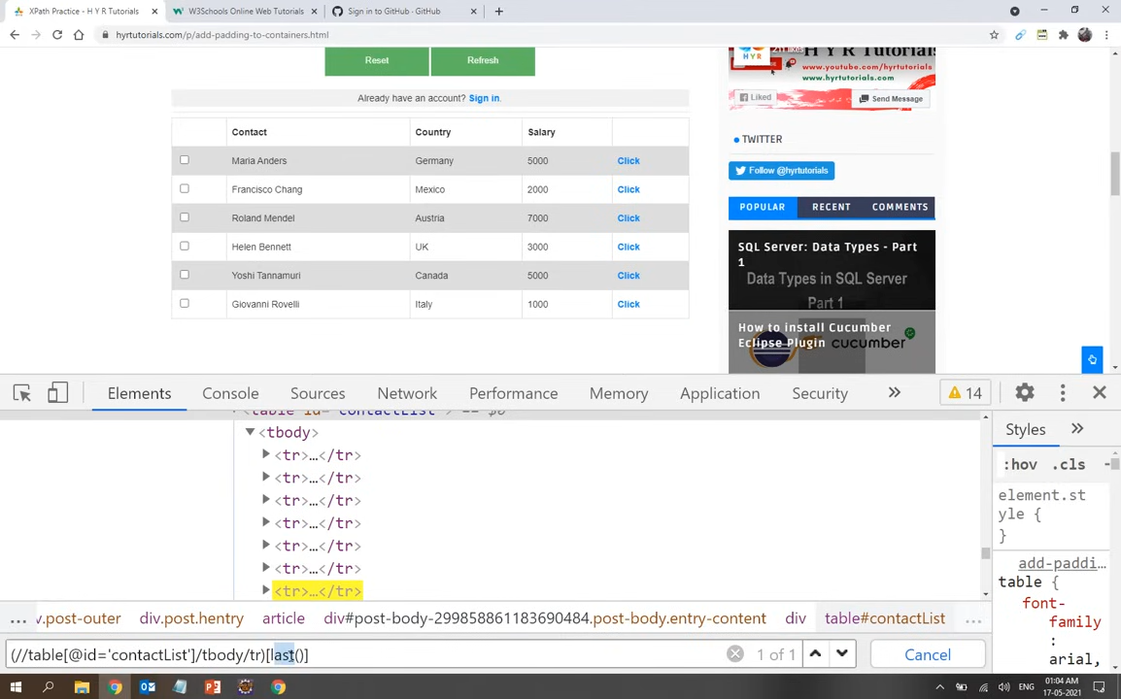

Slide 28
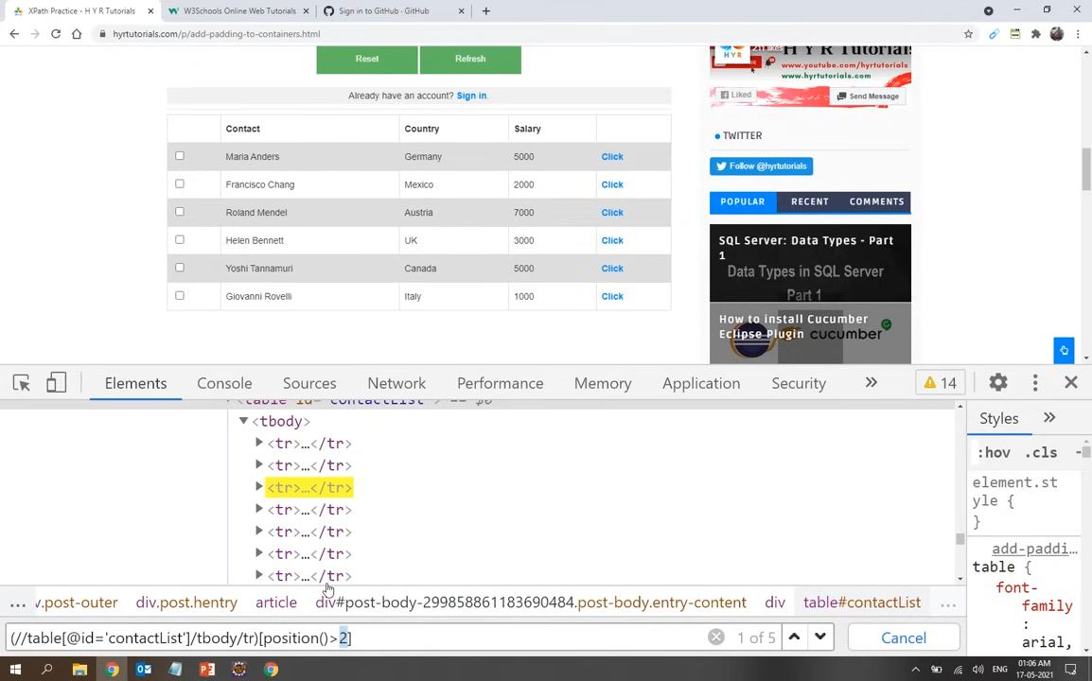

Slide 29
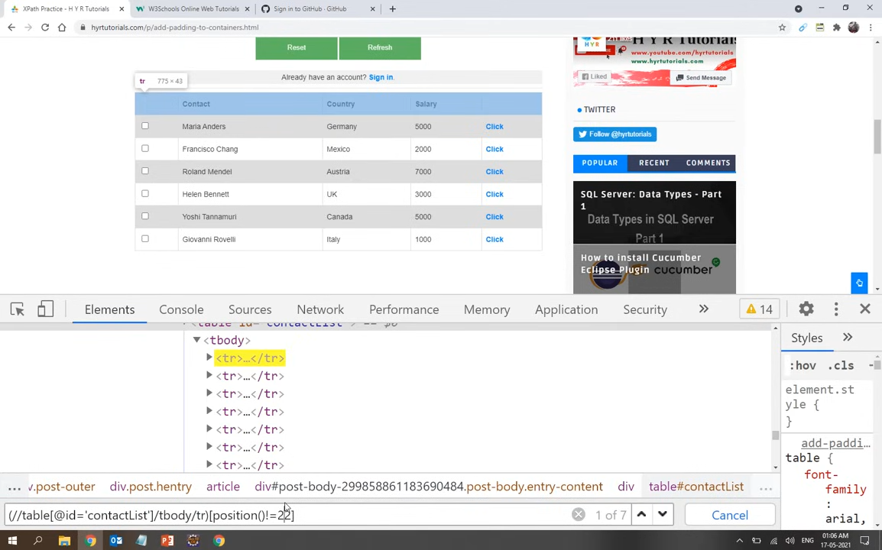

Slide 30


Slide 31
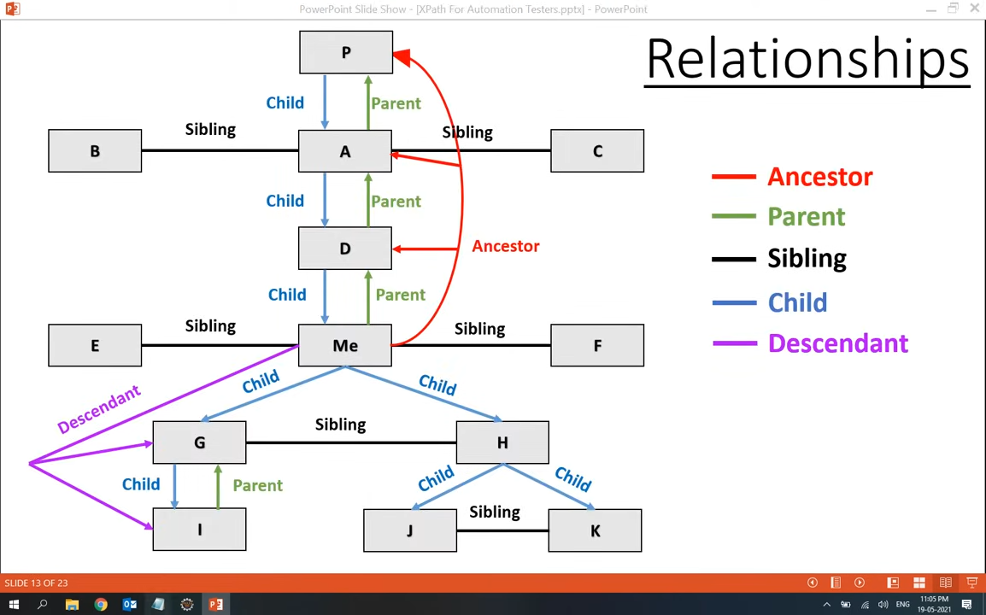

Slide 32
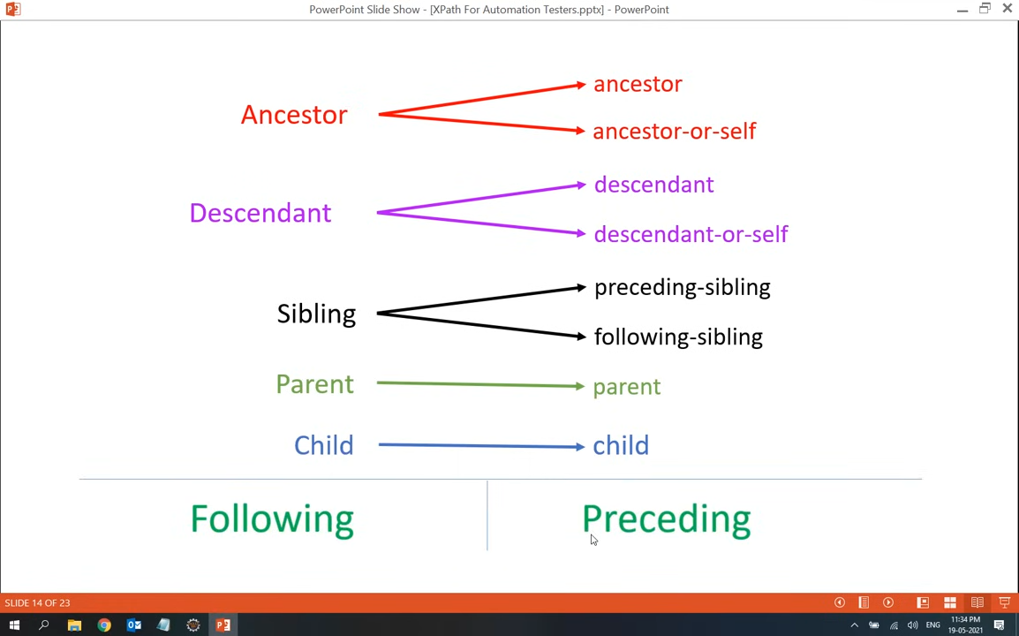

Slide 33
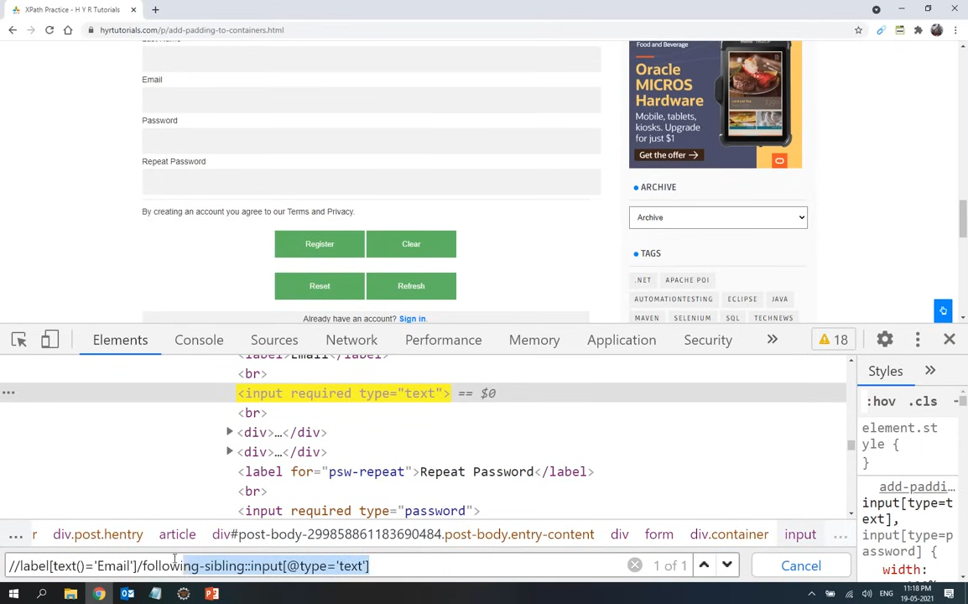

Slide 34
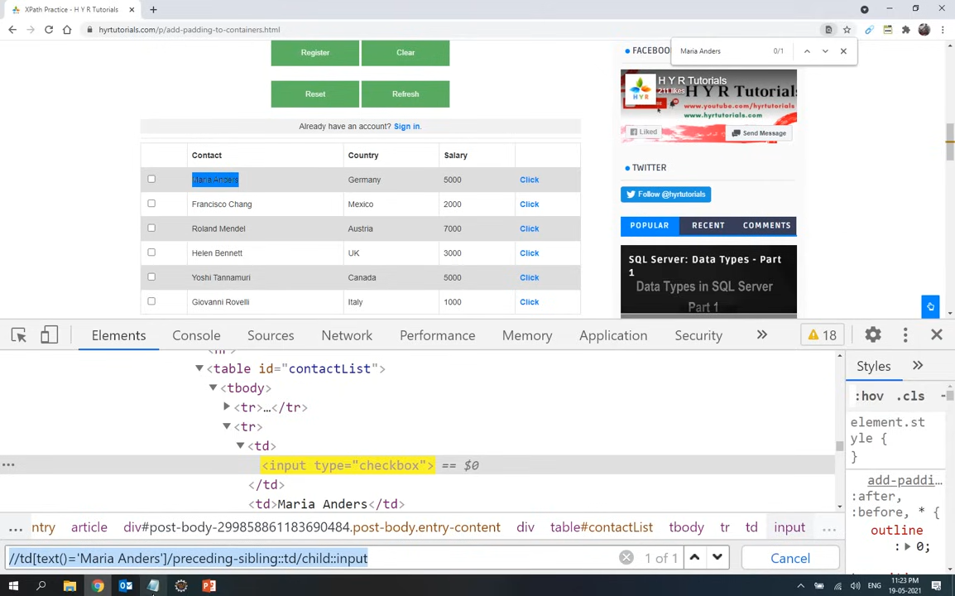

Slide 35
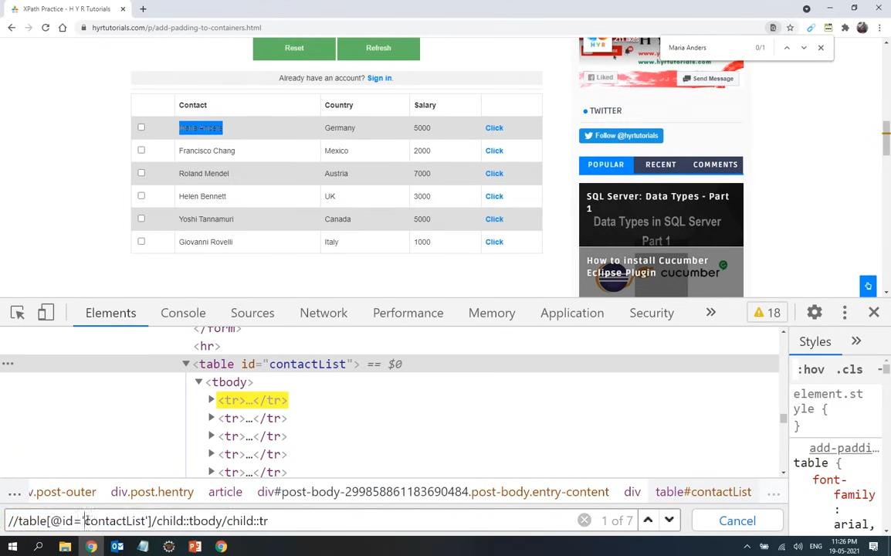

Slide 36
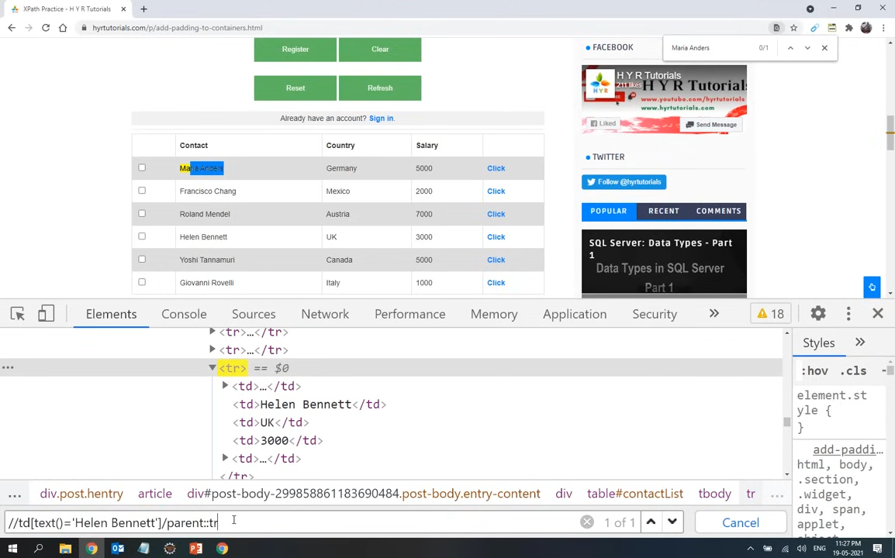

Slide 37
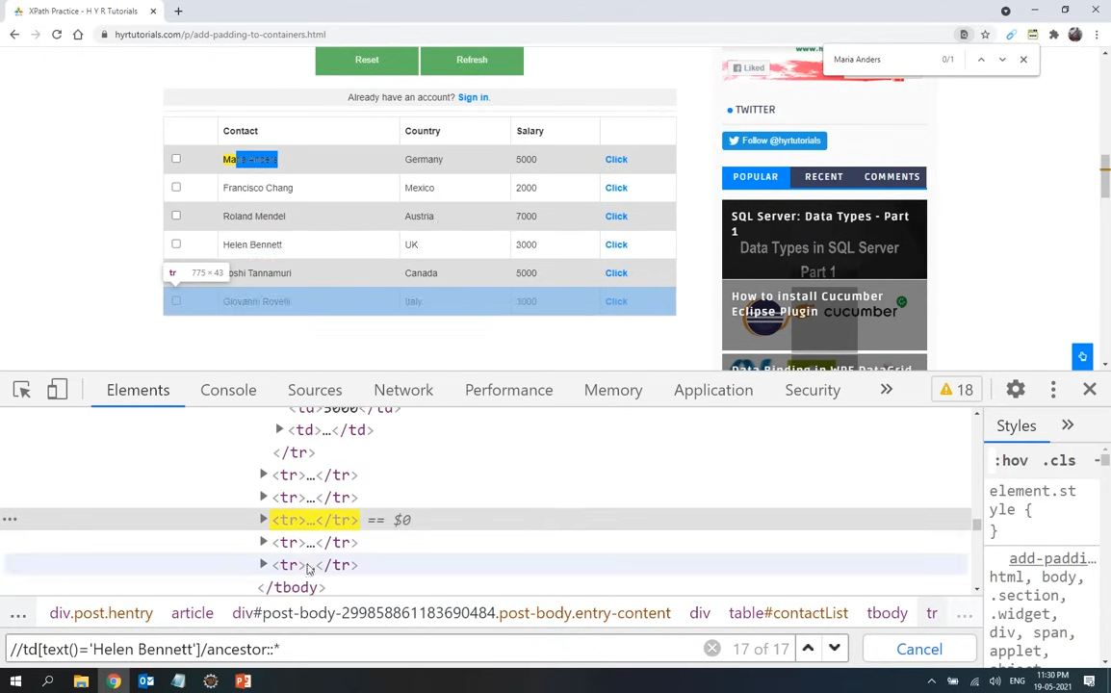

Slide 38
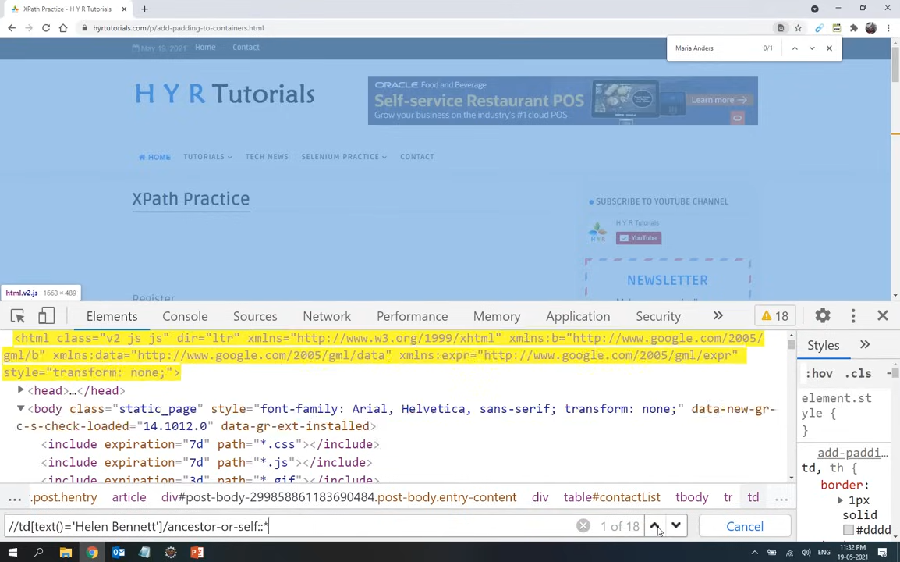

Slide 39
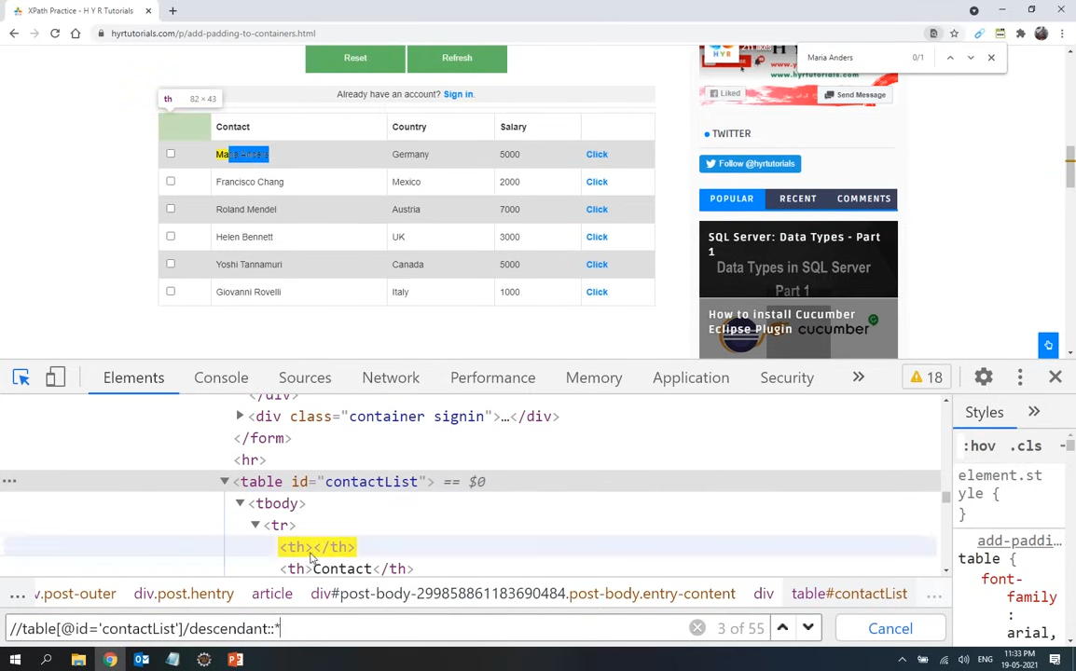

Slide 40
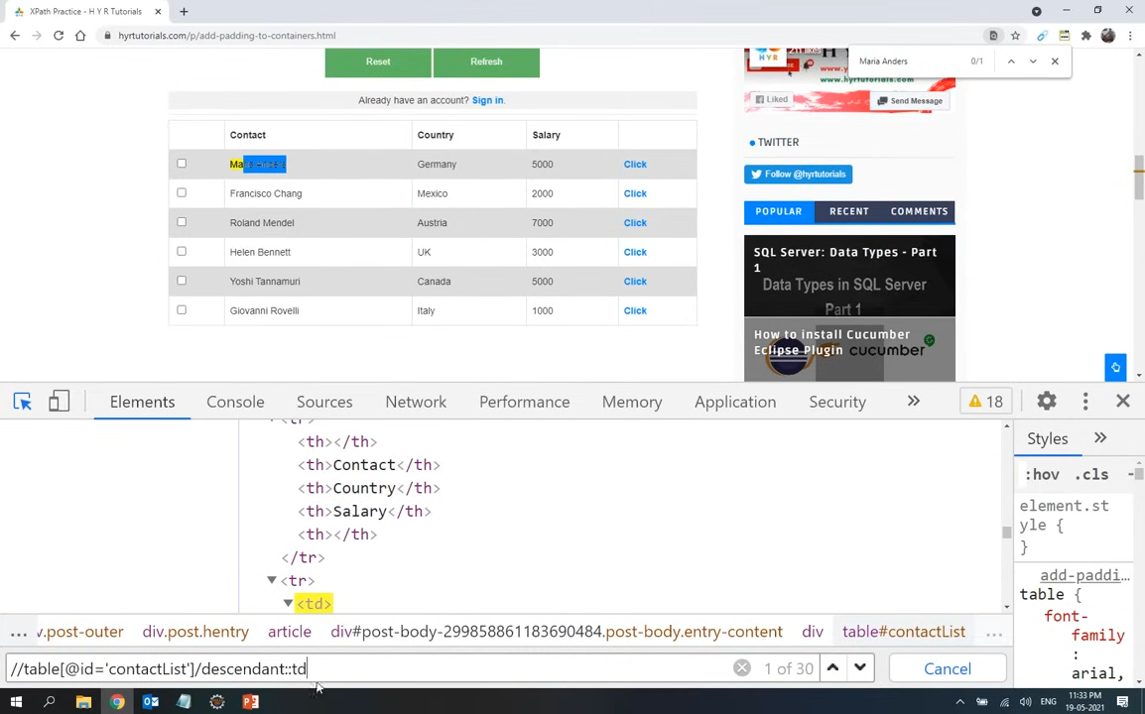

Slide 41
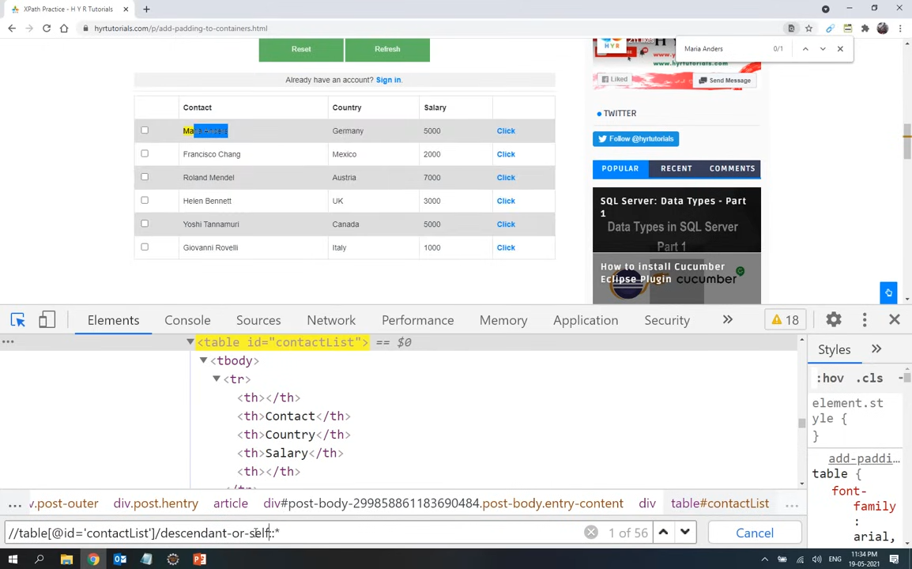

Slide 42
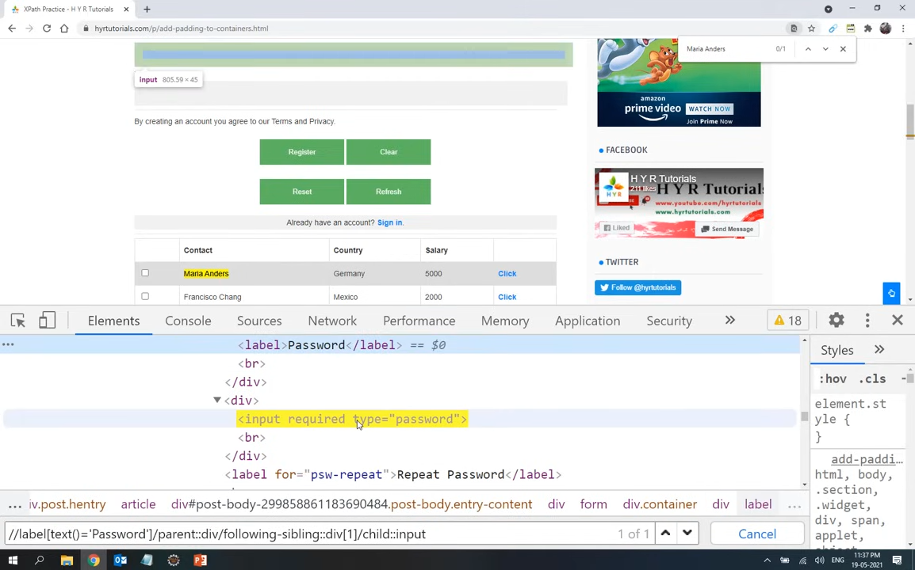

Slide 43
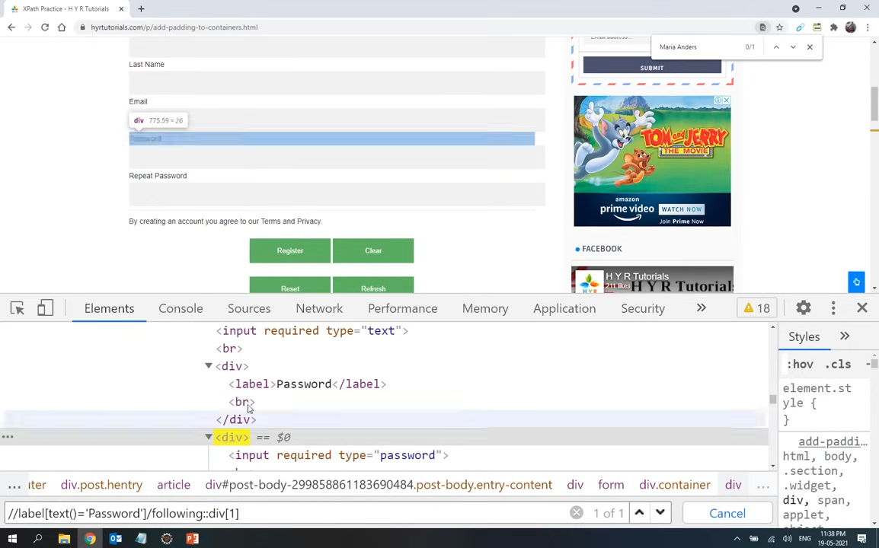

Slide 44
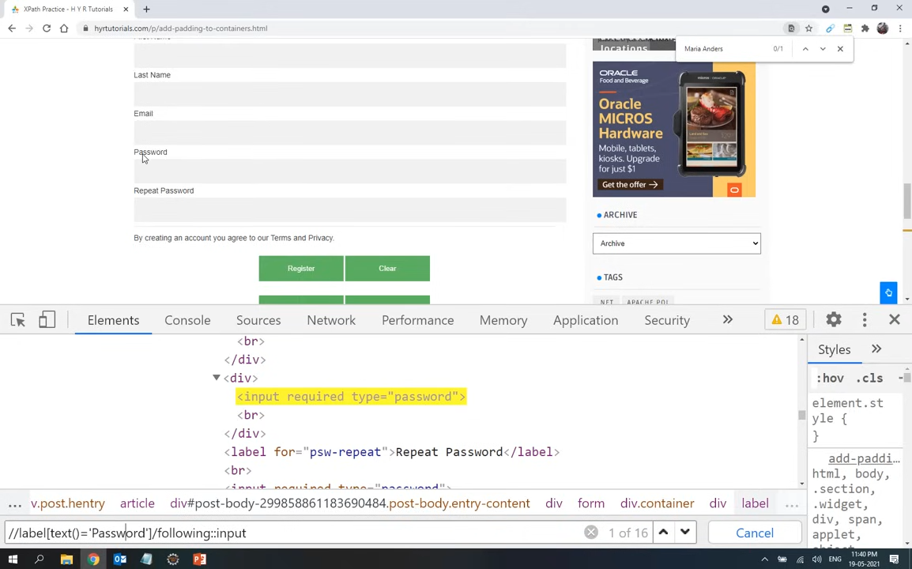

Slide 45
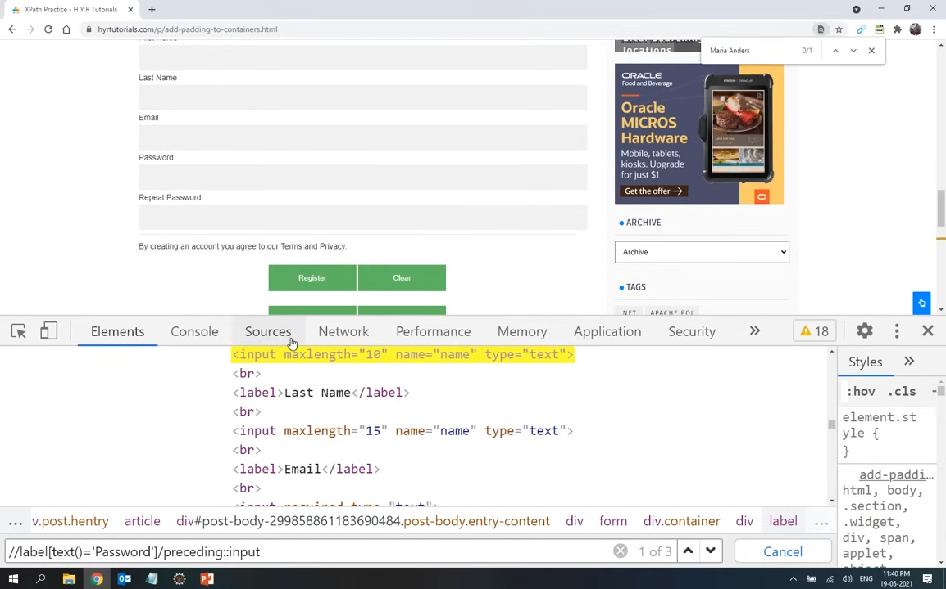

Slide 46
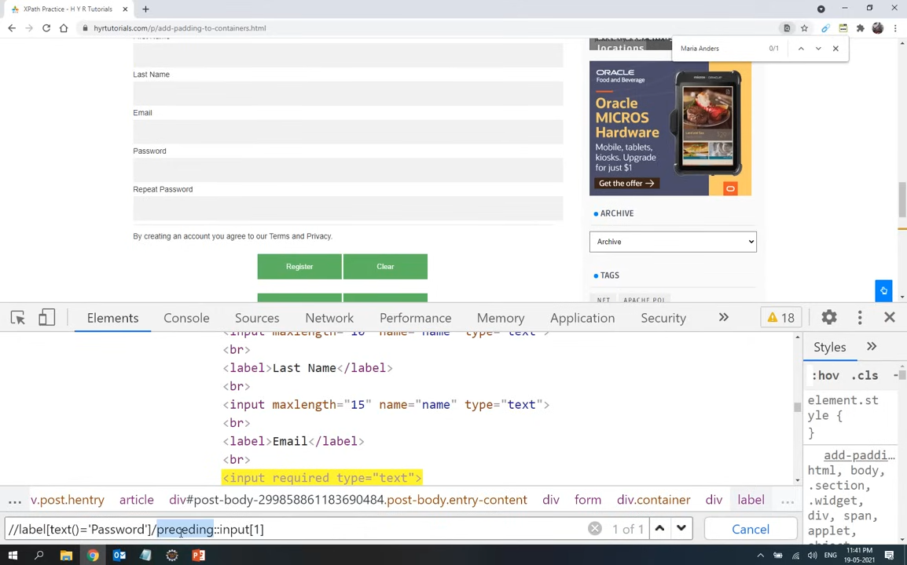


Slide 47
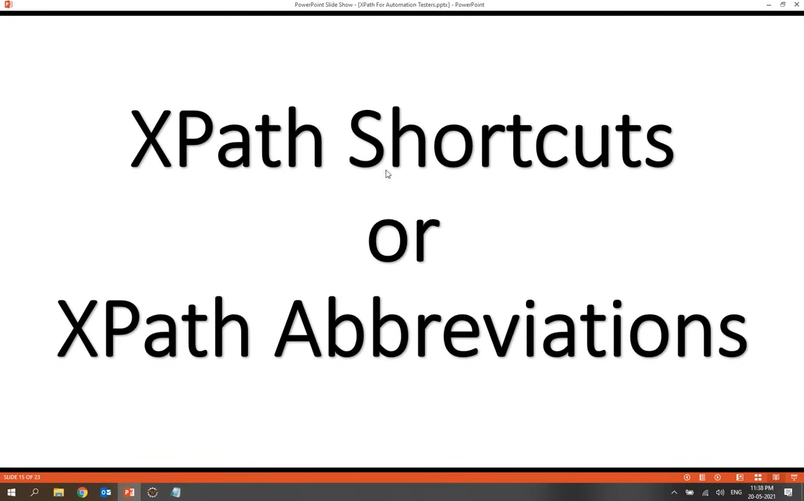

Slide 48
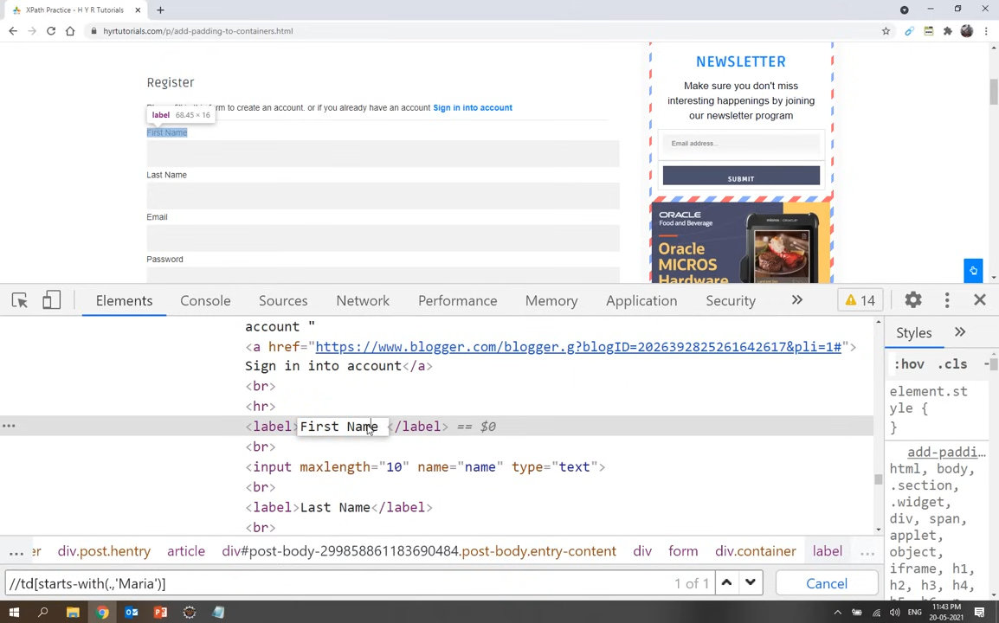

Slide 49
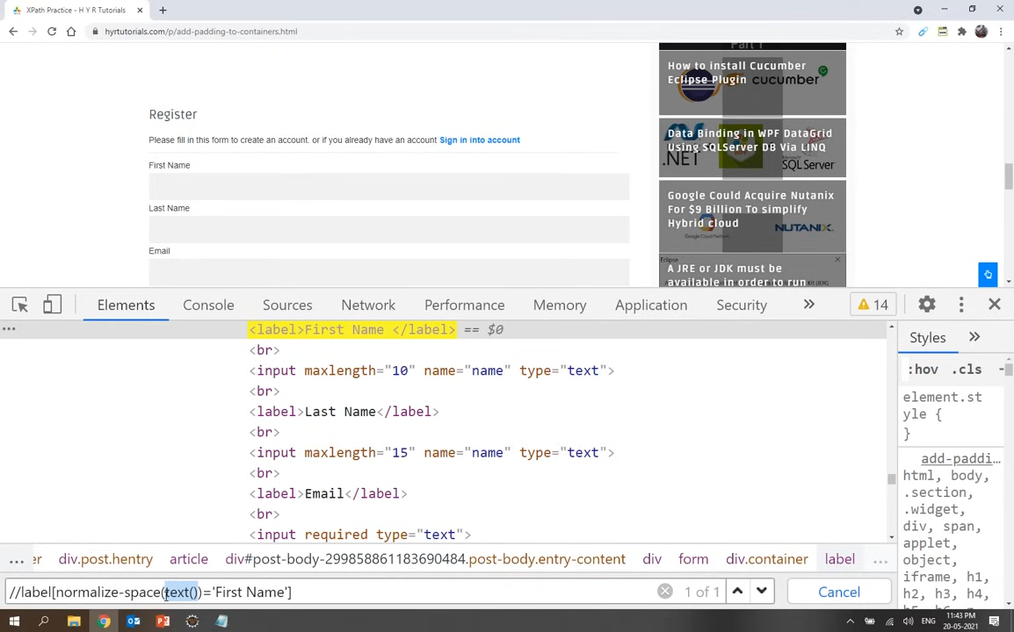

Slide 50
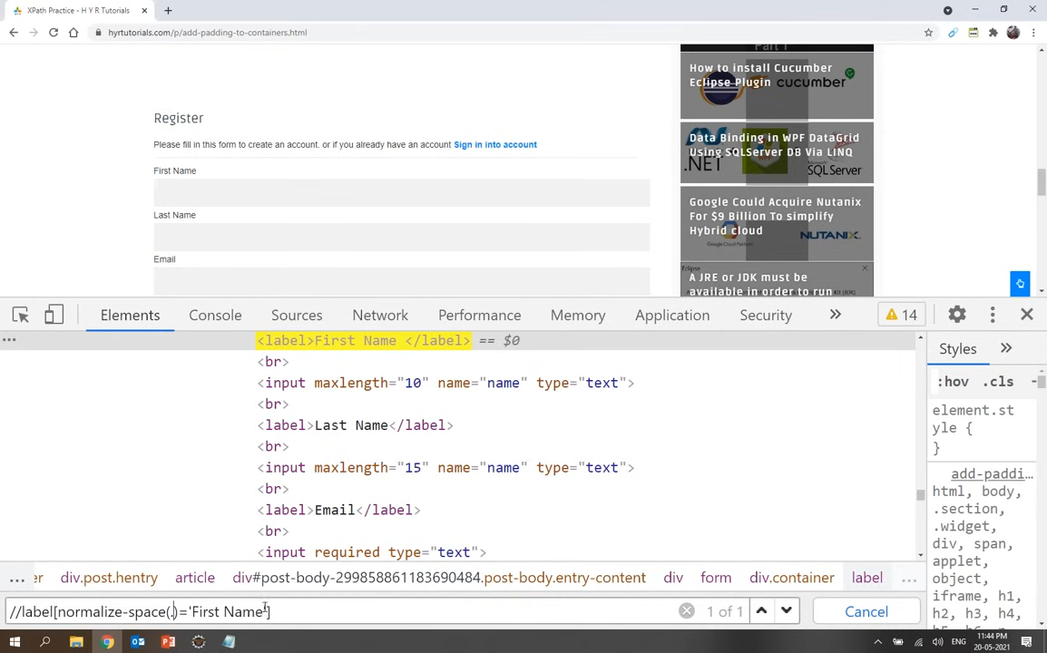

Slide 51
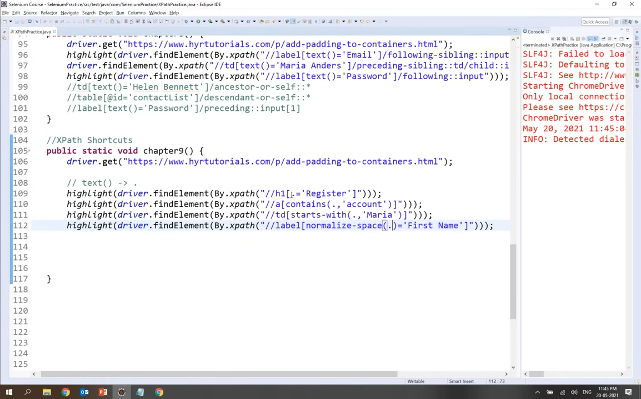

Slide 52
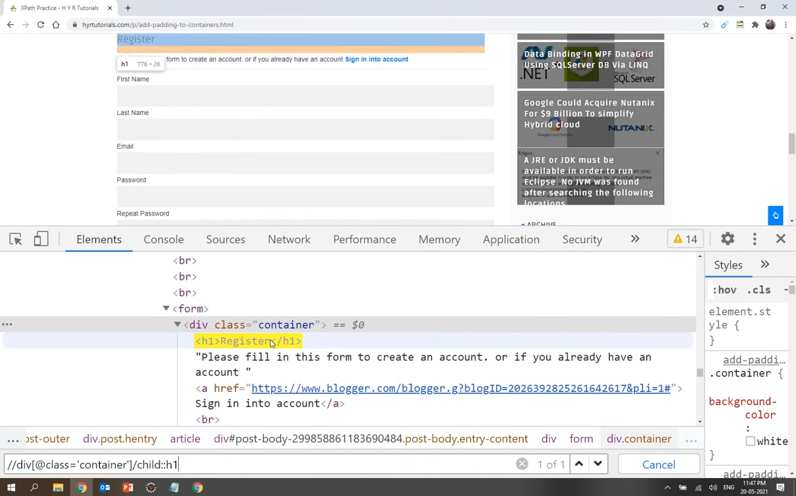

Slide 53
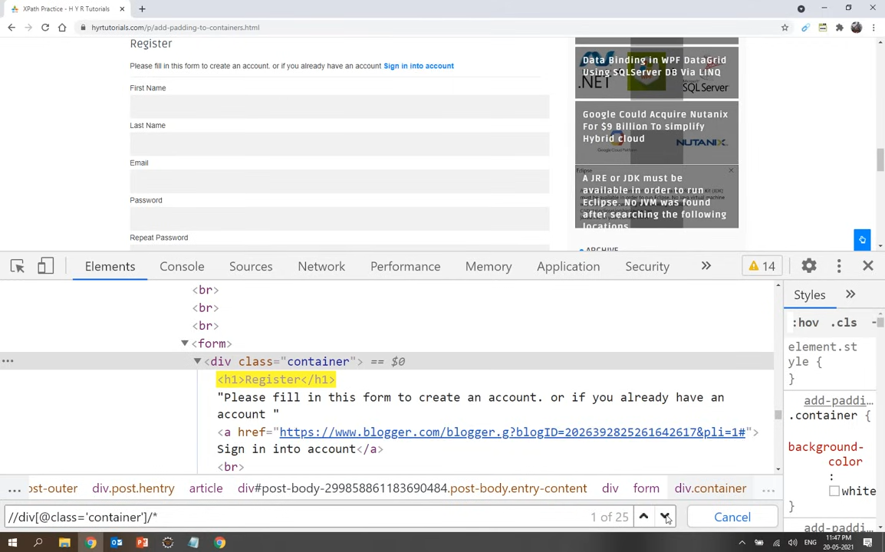

Slide 54
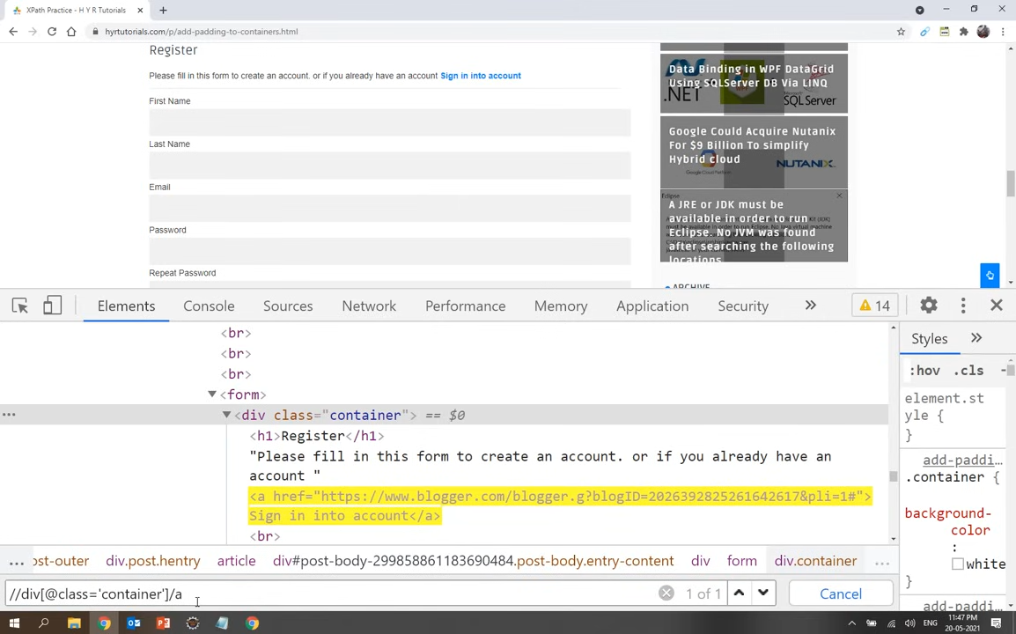

Slide 55
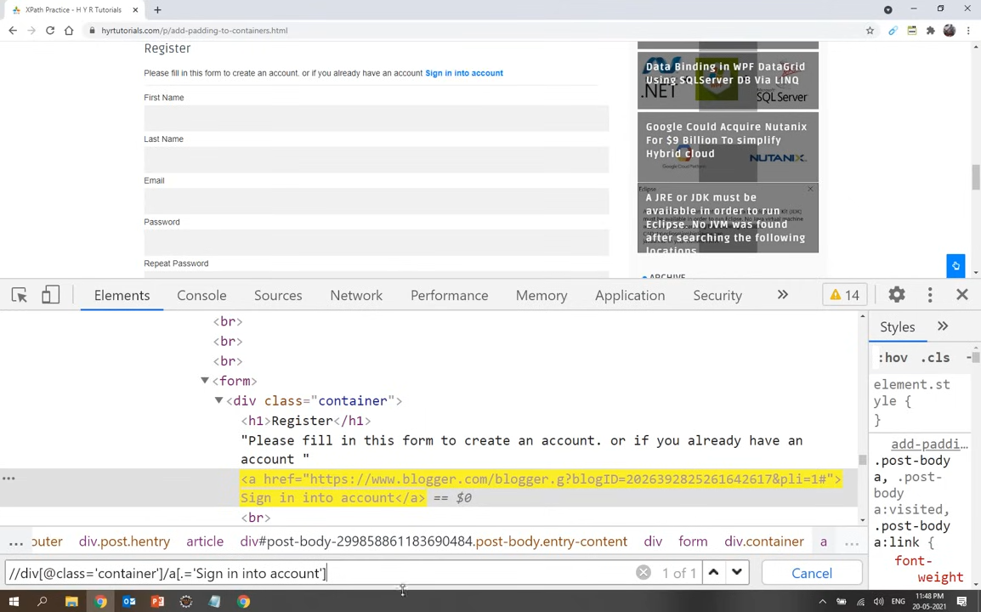

Slide 56
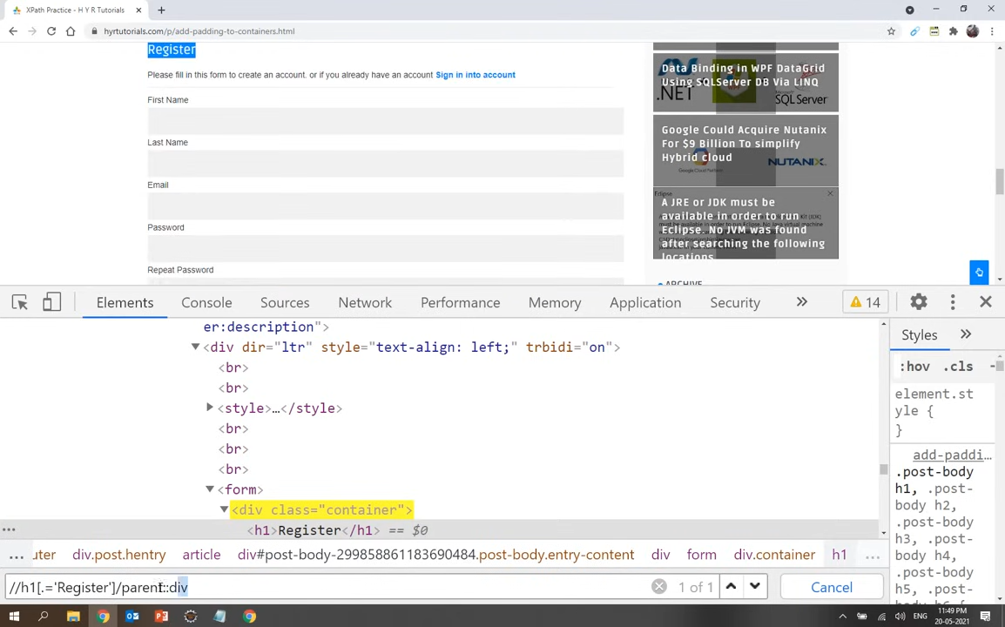

Slide 57


Slide 58
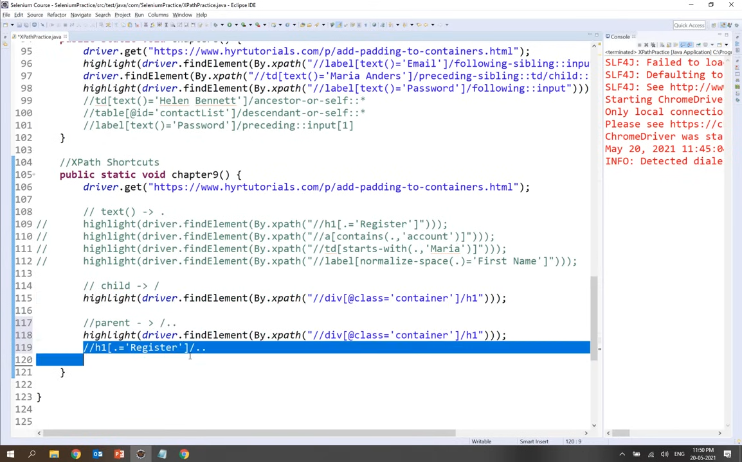

Slide 59
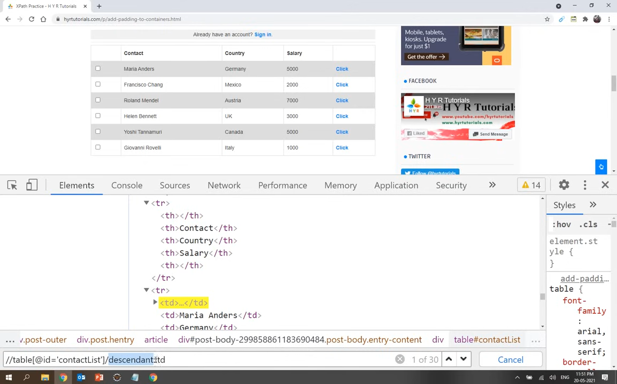

Slide 60


Slide 62


